Slide 1


Healthcare Provider Reviews and Ratings Analysis
Presented by:
Lakhan Jadam

Slide 2
Webscraping and analysis
Send Request to server using request library
Parse html content of page using Beautifulsoup
Data Source
www.healthgrades.com
Extracted information from tags and stored in different lists
Find some important
Tags that contains information
Created dataframe
Using lists
Perform EDA on dataset and visualized
Report and insight

Slide 3
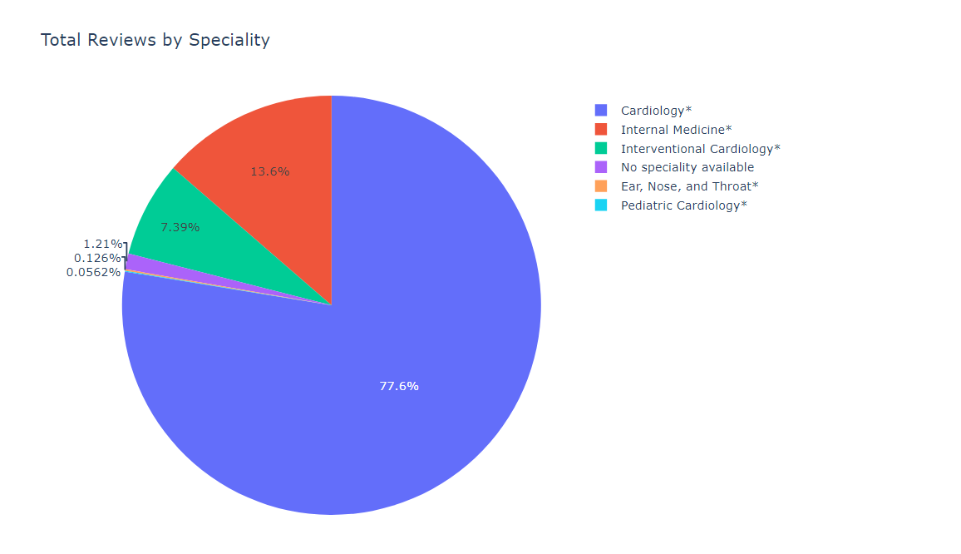
Healthgrade Analysis Report
Key Findings
Distribution of Specialist in New York:
New York has the highest number of cardiologist health providers compared to other specialist.

Slide 4
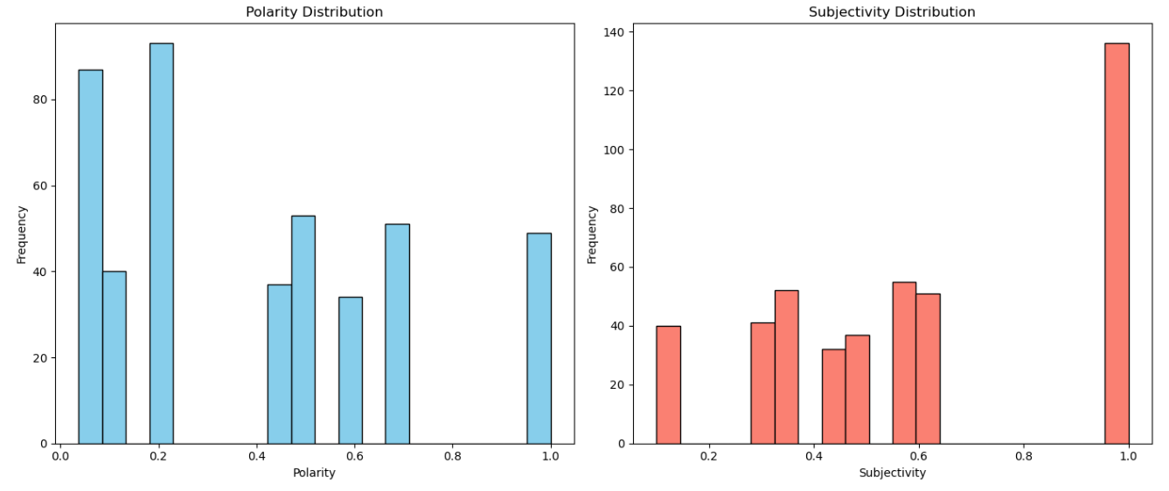
2. Sentiment Analysis of Patient Comments:
Polarity: A higher number of negative comments were observed in the polarity analysis, indicating that many patients expressed dissatisfaction.
Subjectivity: In contrast, the subjectivity analysis revealed a significant number of positive comments, suggesting that when patients did provide positive feedback, it was often expressed strongly.

Slide 5
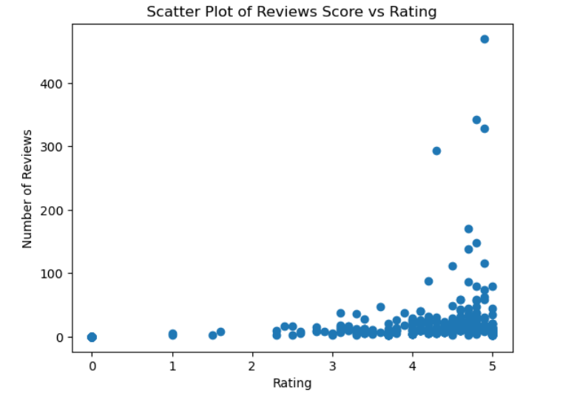
3. Overall Ratings Based on Number of Reviews:
For health providers with fewer than 100 reviews, the average rating typically fell between 2.5 and 5.
However, for those with more than 100 reviews, the ratings tended to be higher, generally ranging from 4 to 5. This indicates that more established providers received better ratings.

Slide 6
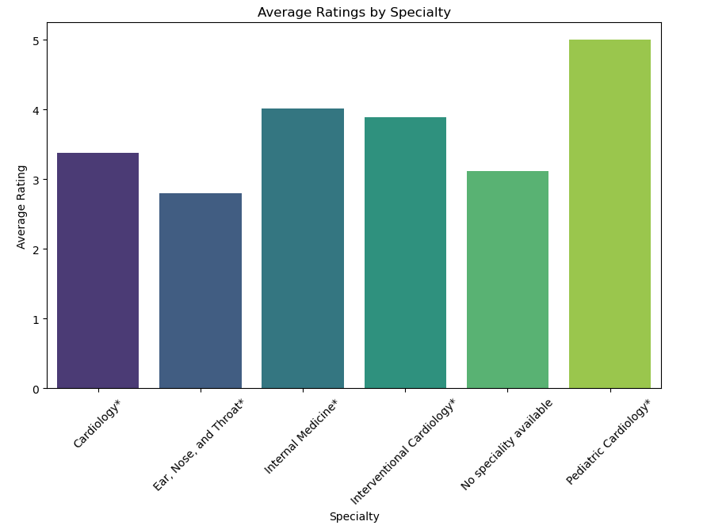
4. Average Ratings by Specialty:
Pediatric cardiologists received the highest average ratings, typically between 4 and 5, suggesting strong performance in this specialty.

Slide 7
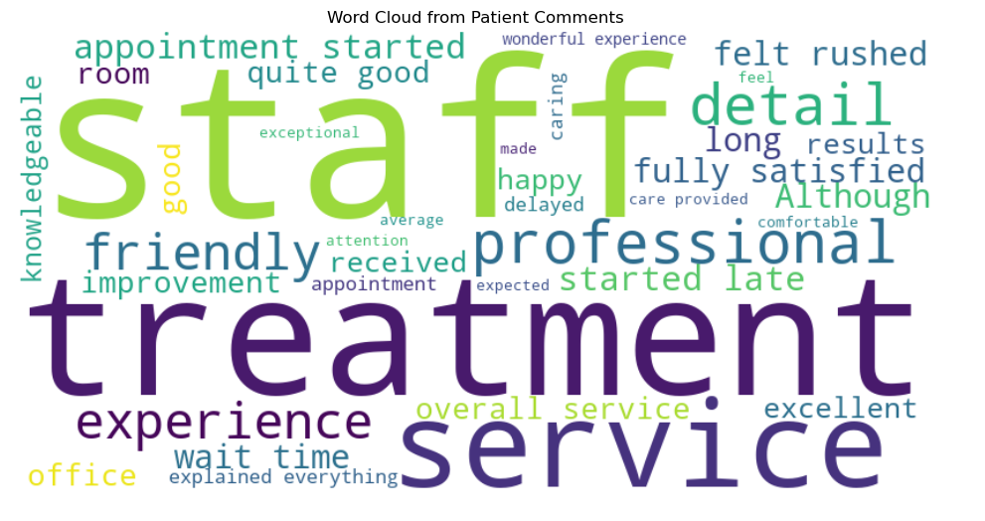
5. Word Cloud Analysis of Patient Comments:
Common words found in patient comments included "treatment“, "staff“, "good" ,"excellent“, and "wait time" This indicates that patients frequently mention these aspects when discussing their experiences.

Slide 8
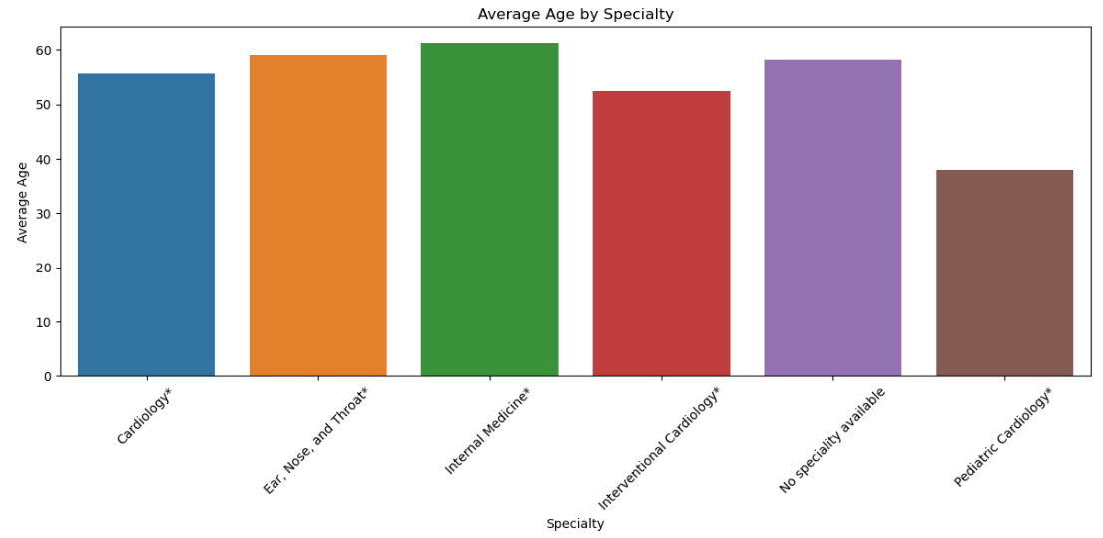
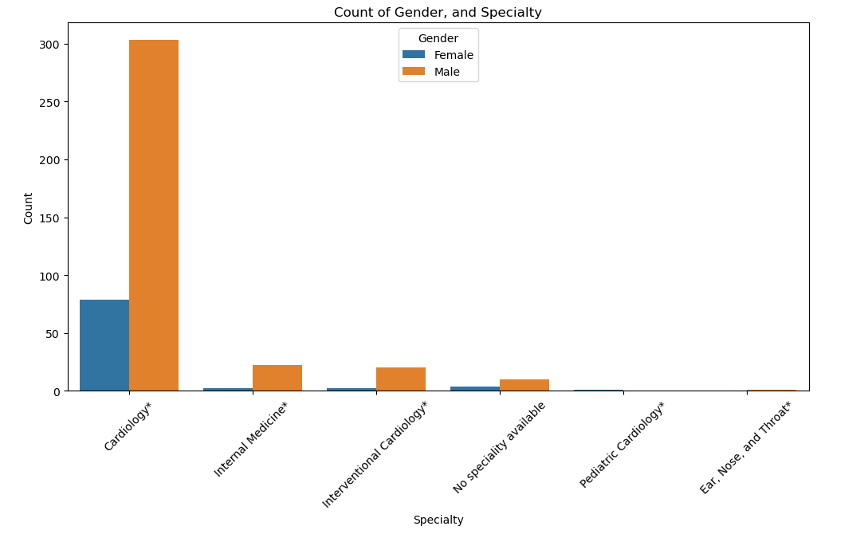
5. Demographics of Health Providers:
The analysis of age and gender among health providers showed that the majority of male cardiologists are aged between 50 and 60.
In the specialty of pediatric cardiology, most providers are under the age of 40.

Slide 9
Conclusion
This analysis highlights important trends among health providers in New York. There are many cardiologists available, which is good for patients. However, patient comments show a mix of feedback, with more negative remarks than positive.
Providers with more reviews tend to have better ratings, showing that building a strong reputation is essential. Pediatric cardiologists received the highest ratings, suggesting they excel in their field.
Key themes from patient comments include treatment quality and staff interactions. The analysis of age and gender among providers also suggests opportunities for better recruitment and training.
Overall, these findings can help improve patient care and provider performance, leading to better health outcomes. Addressing negative feedback while highlighting successful specialties like pediatric cardiology will enhance patient experiences.

Slide 10
THANK YOU

